Slide 1
Introduction to SQL(Structured Query Language)

Slide 2
Things you will learn-
What is a database and how they are made?
Why using databases?
Write basic queries with SQL

Slide 3
What is a Database?
Definition – organised collection of information persisted in computer’s memory or on a hard disk.
e.g- Relational Database (collection of two-dimensional tables composed of rows and columns)

Slide 4
Glossary
Table
Schema
Row
Column

Slide 5
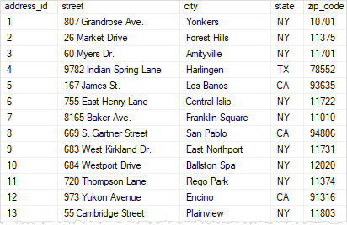
Table
Each table, or relation, is comprised of rows and has well-defined columns (fields) that specify a datatype and a name for all the data in the column.

Slide 6
Row
Also called a record or entry, a row represent a specific instance of data within a table. If we had a customers table in our database, each row would represent a different customer.

Slide 7
Column
Also called a field, each column has a name and stores information of a particular type, or data type, for each record in a table. Collectively, all columns in a table comprise the structutre for each record.

Slide 8
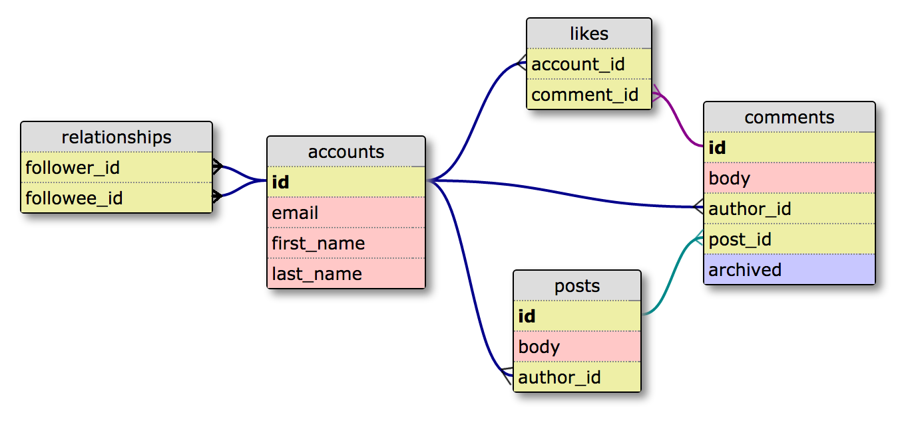
Schema
A schema is a collection of tables and the relationship between those tables

Slide 9
Common Data types
Numeric Data Types:
INT: Integer up to 10 digits.
BIGINT: Integer up to 19 digits.
FLOAT: Floating decimal point number.
Text Data Types:
CHAR: Fixed-length string with fixed length (up to 255) specified in parentheses.
VARCHAR: Fixed-length string with max length (up to 255) specified in parentheses.
TEXT: String with a max length of 65,535 characters.
Date Data Types:
DATE: Date formatted as YYYY-MM-DD.
DATETIME: Date and time formatted as YYYY-MM-DD HH:MI:SS.
TIME: Time formatted as HH:MI:SS.

Slide 10
SQL statements
CREATE TABLE table_name(
column_1_name data type,
column_2_name data type,
column_3_name data type
);

Slide 11
Quering Data
SELECT: Allows you to choose the specific fields you would like displayed in your query results.
FROM: Allows you to specify what table in the database the data is going to come from.
WHERE: Allows you to specify some conditions to filter the data.
GROUP BY: Allows you to specify by which fields you want to group your data.
ORDER BY: Allows you to sort the data in ascending or descending order by multiple fields.
LIMIT: Limits the output by certain number of first rows.

Slide 12
Example
Select *
From ratings;
Select AppName, Price, TotalRatings, OverallRating, Genre
From ratings
Where Price = 0 and OverallRating >= 4
Order by TotalRatings Desc
Limit 20;
General case
Select column_name1, column_name2, …,column_name_last
From table_name
Where condition1 and condition2 and …,condition_last
Order by rule [Desc]
Limit number_of_rows;

Slide 13
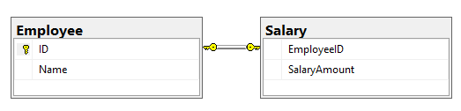
Relationships
(One to one)

Slide 14
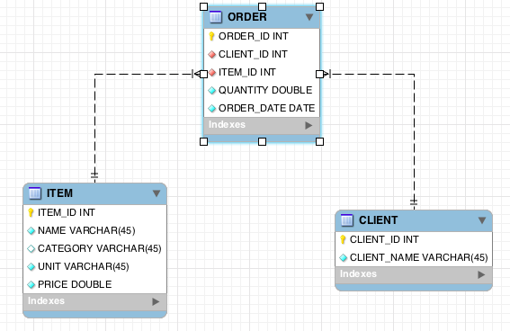
One to many

Slide 15
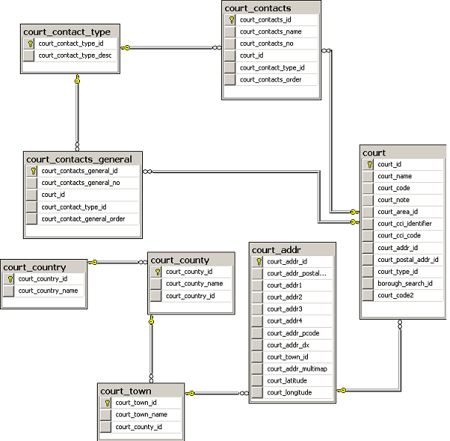
Many to many

Slide 16

Instructions to get the data
Download publications.sql.zip. (https://bit.ly/2BlWObF)
Unzip the downloaded file and extract the database dump file on your machine.
In MySQL Workbench / Sequel Pro, create a new database called "publications" by running the following command:
publications;.
Select Database by running the following command: .
Import data:
  Mac: From the top menu, select File and then the Import menu option. Navigate to the publications.sql dump file and import it.
  Windows: Just open sql file and run it.

Slide 17
Joins
INNER JOIN - only those which exist in both tables
LEFT JOIN - all the records from left table + those who matched in right one
RIGHT JOIN - all the records from right table + those who matched in left one
OUTER JOIN - all records from both tables

Slide 18


Slide 19
Examples
Select pubs.pub_name, COUNT(titles.title_id) AS Titles
From publications.publishers pubs
LEFT JOIN publications.titles titles
ON pubs.pub_id = titles.pub_id
GROUP BY pubs.pub_name;
Select pubs.pub_name, COUNT(titles.title_id) AS Titles
From publications.publishers pubs
INNER JOIN publications.titles titles
ON pubs.pub_id = titles.pub_id
GROUP BY pubs.pub_name;
Select *
From publications.employee emp
LEFT JOIN publications.jobs job
ON emp.job_id = job.job_id
UNION
Select *
From publications.employee emp
RIGHT JOIN publications.jobs job
ON emp.job_id = job.job_id

